Slide 1
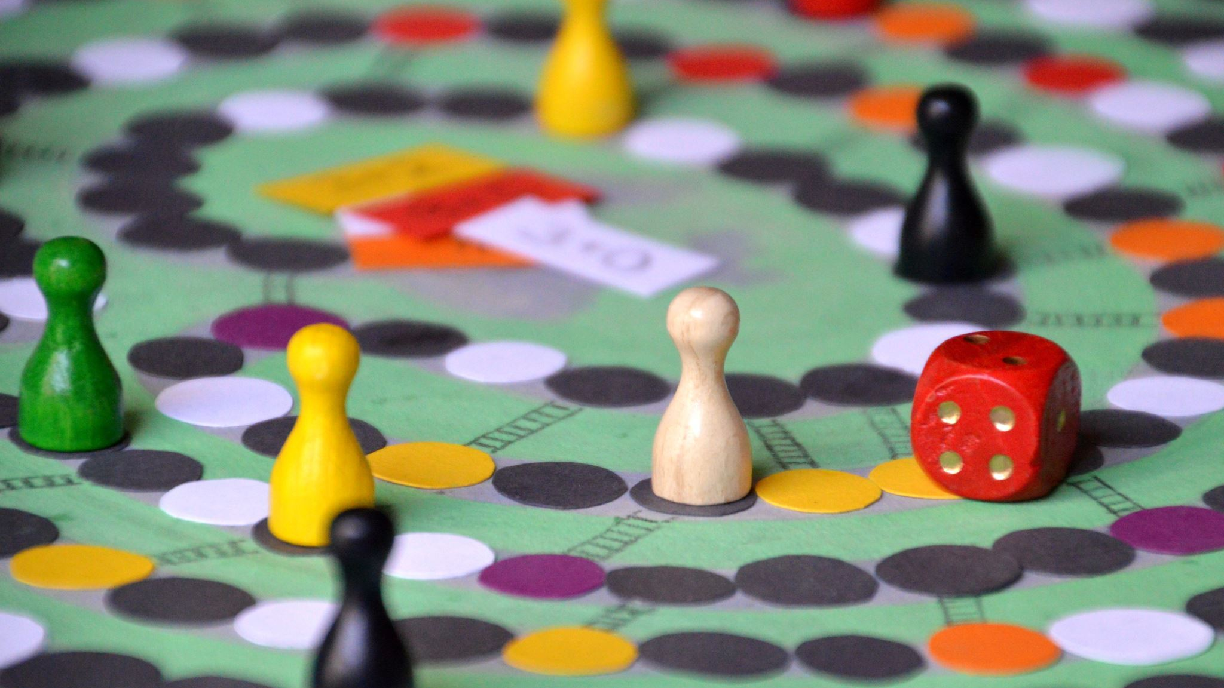
Tile Matching Game
Ertuğrul Ege eyiler

Slide 2
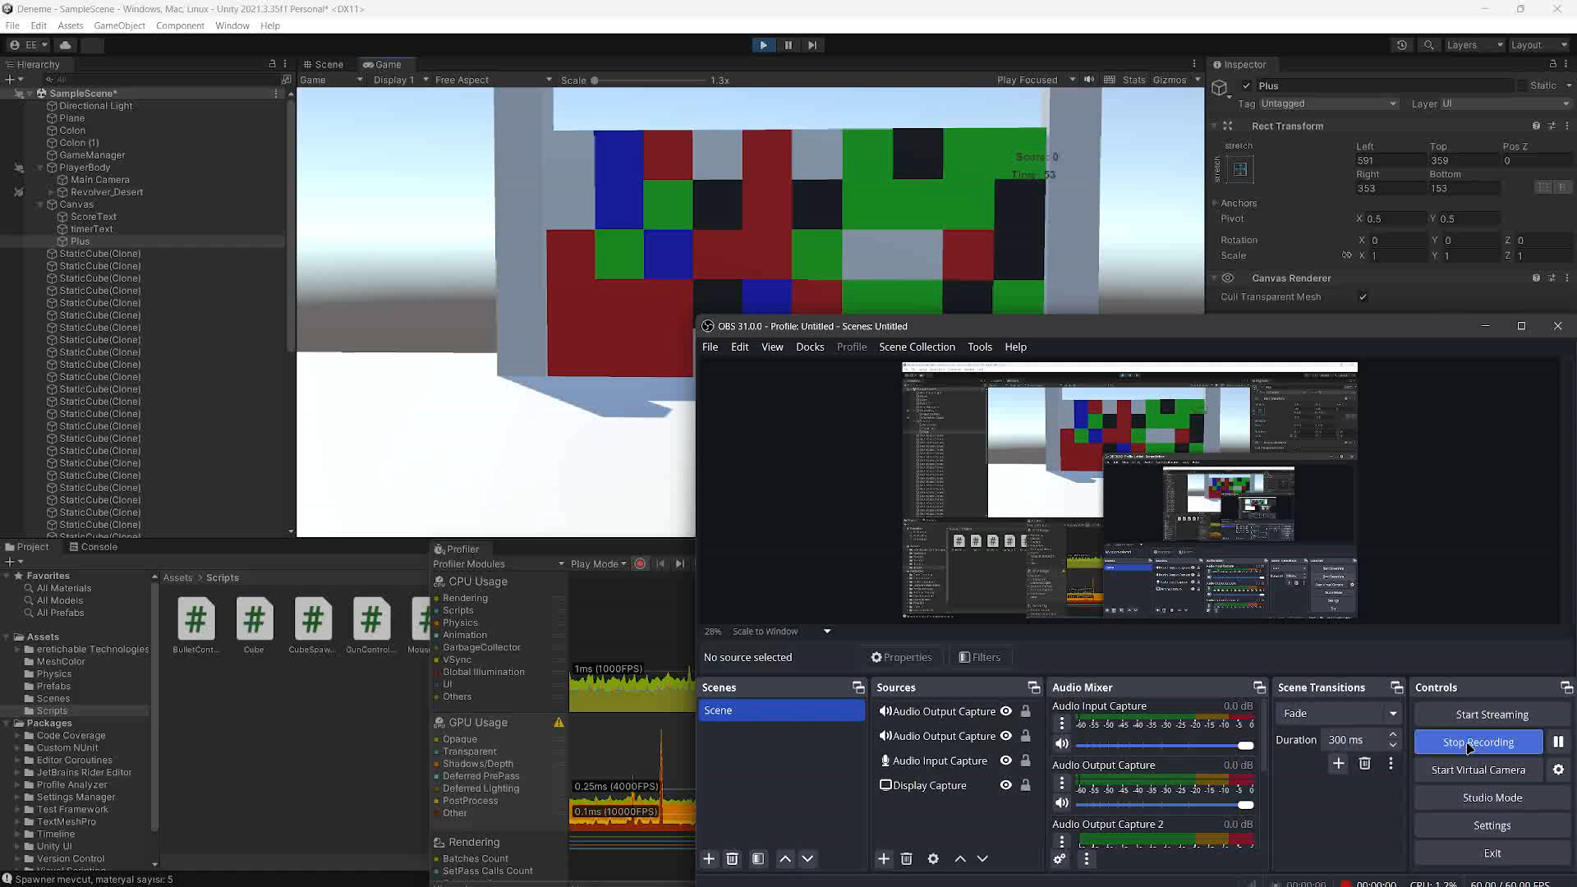
Game Demo

Slide 3
Technical Challenges
1. Assigning Colors to Numbers and Matrix-Based Algorithm
2. Detecting and Destroying Adjacent Cubes
3. Collision Detection
4. Cube Falling Mechanic and Bounce Effect
5. Score and Time Management

Slide 4
Game Mechanics
Rules: 1) Match adjacent cubes of the same color to destroy them. 2)Gain points based on the number of cubes destroyed simultaneously
Aims:
1)Achieve the highest score within the time limit. 2)Utilize strategic matches to maximize points and time bonuses.

Slide 5

Conclusion
Successfully developed a tile-matching game with realistic physics and engaging mechanics.
Overcame technical challenges such as custom matching algorithms and collision detection.
Demonstrated efficient performance through Unity Profiler evaluations.
Implementing multiplayer functionality.
Enhancing visuals and sound effects.

